Slide 1
Project 1 - Study on the most and least COVID-impacted areas in the United States
Study of the CDC’s Report on Community COVID-19 Levels by County
By Team 6
(Emily Elzinga, Luna Steed, and Tanzim Mostafa)

Slide 2
Introduction / Background
Our study covers data on how COVID-19 spread throughout the United States and its territories.
The data consists of weekly measurements of the cases per 100k, hospital admissions per 100k, and bed utilization for each county in the United States between February and October of 2022. The data also has each county’s population.

Slide 3
Goals of Research
Analyze the states with the highest and lowest median cases to analyze.
Analyze Idaho
For the 3 states, find and analyze key metrics of the counties with the highest and lowest median cases
Examine how COVID progressed month to month in each state and if there were any commonalities among the data (county population affecting medians, trends in bed utilization vs. hospitalizations, and monthly COVID cases).

Slide 4
Methodology
We decided to use Median to gather data, as it is not susceptible to outlier data points, which may be important in a large data set like this.
We took the medians of the data, first grouped by state and date updated in order to find the states with the highest median cases and the lowest median cases. We also selected Idaho, because of ISU’s location.
After this, we took the medians of the columns of interest to us, slicing the data frame for our states and grouping by county and date updated.
We plotted the hospitalizations against the bed utilization and used Seaborn to find the line of best fit.
We also plotted the median cases and hospitalizations month-by-month via pandas.

Slide 5
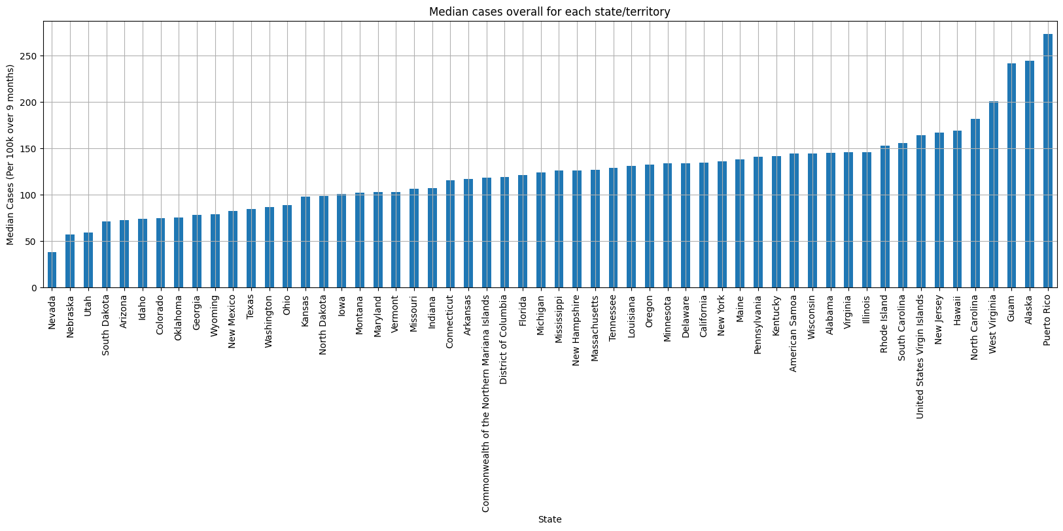

Slide 6
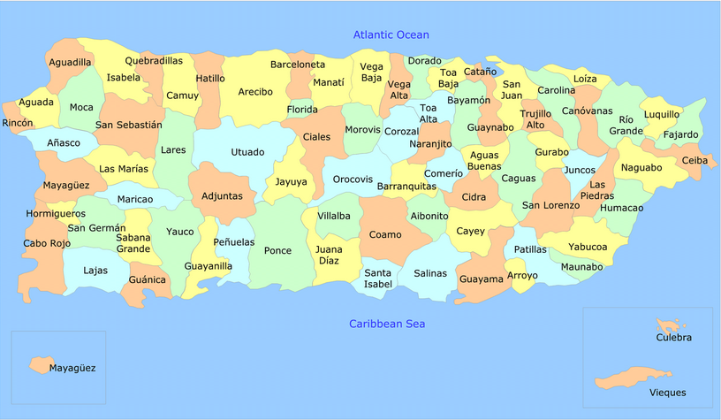
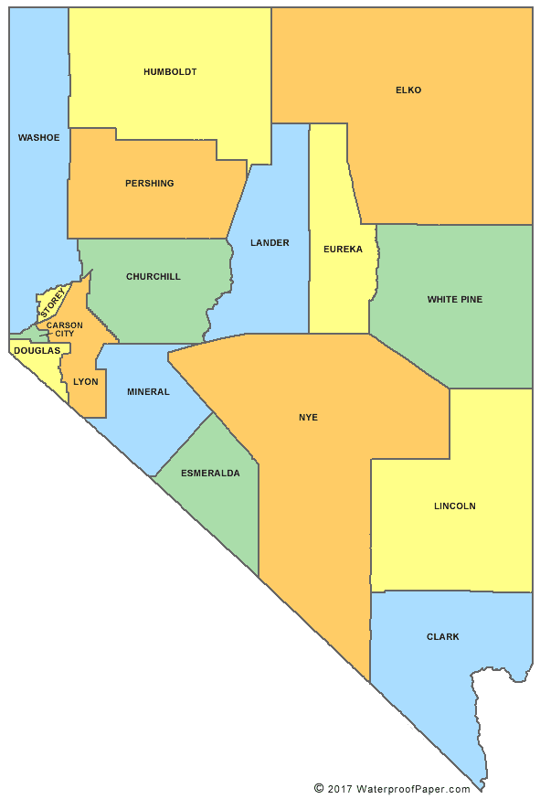
What states had the most and least amount of COVID Cases?
Most Median Infections: Puerto Rico
Least Median Infections: Nevada

Slide 7
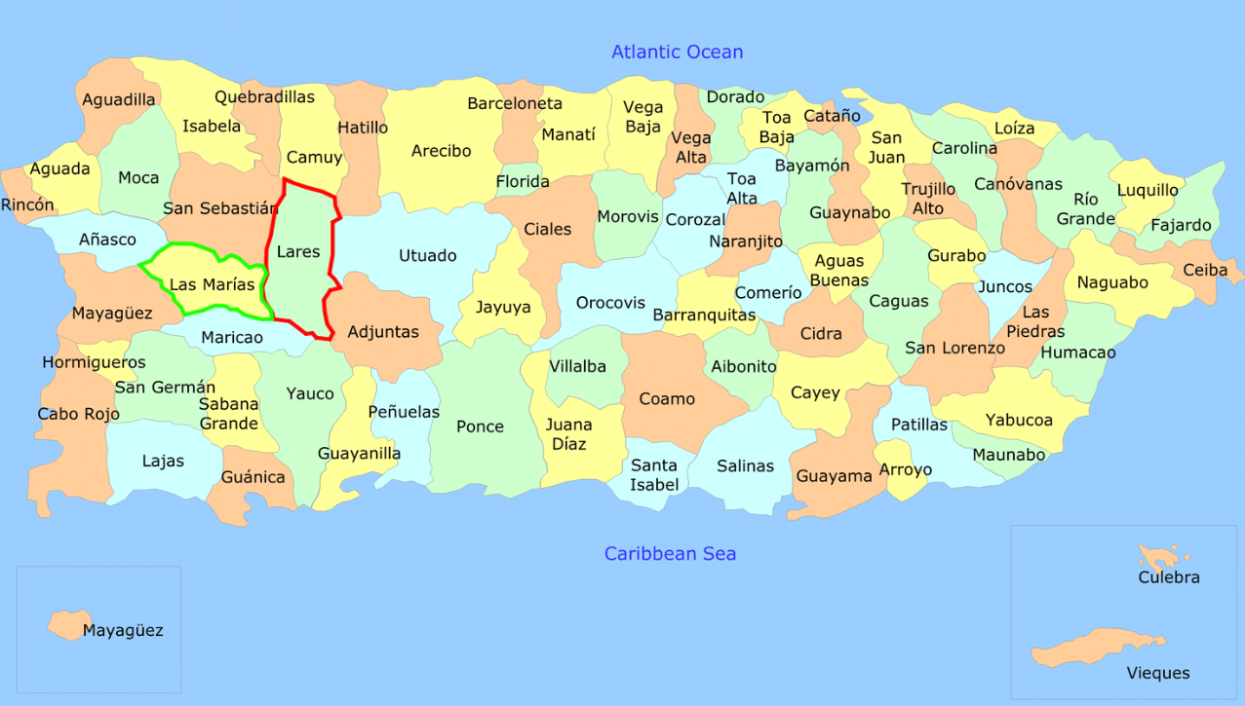
Puerto Rico
Puerto Rico had the highest median cases over time at 273.48 median cases over the 9 months covered in the study.
The Puerto Rican county with the most median cases over the study was Lares Muni, with 580.2 median cases over the 9 months of the study. (Highlighted red)
The county with the least was Las Marías Muni with only 138.77 median cases over the length of the study. (Highlighted green)

Slide 8
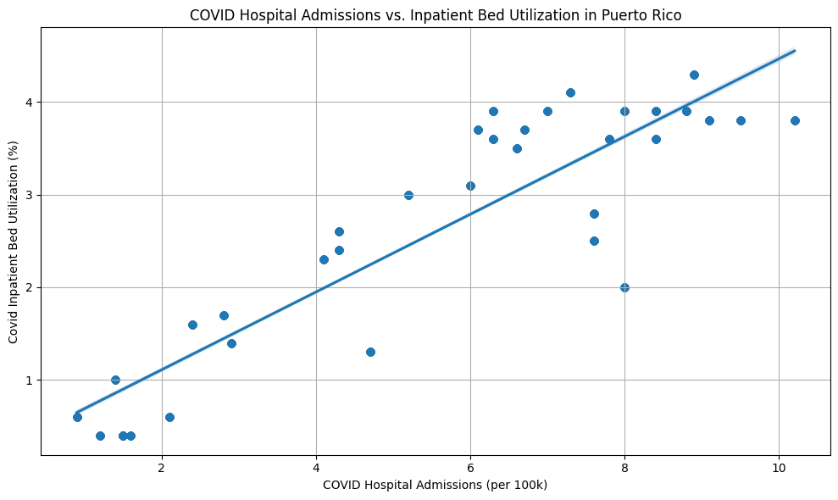
Puerto Rico Hospital Admissions vs. Inpatient Bed Utilization*
* Puerto Rico’s bed utilization was the same for all counties month by month, indicating the data was recorded for all of Puerto Rico rather than for each county.

Slide 9
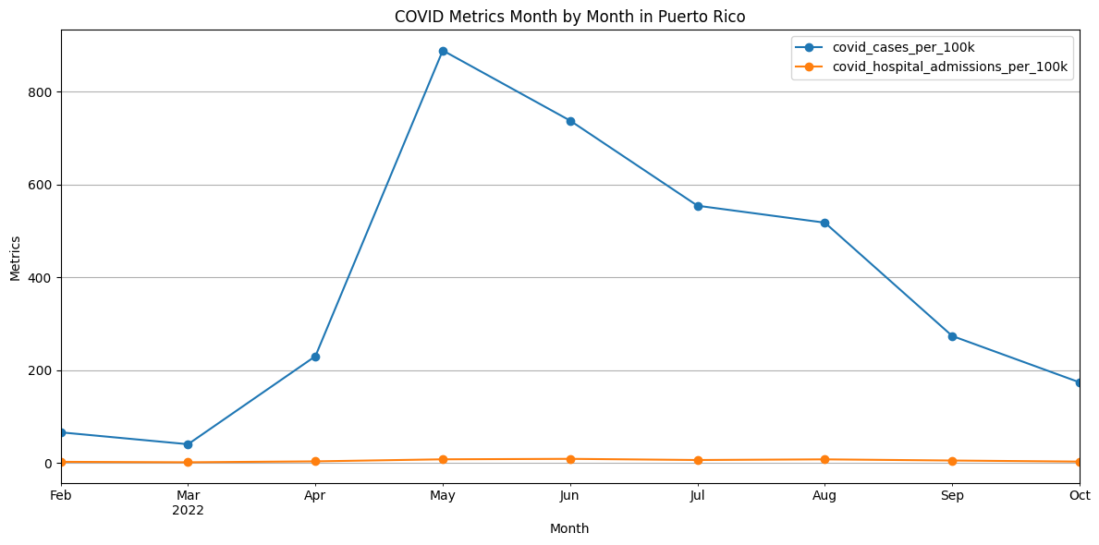
Median metrics month by month in Puerto Rico

Slide 10
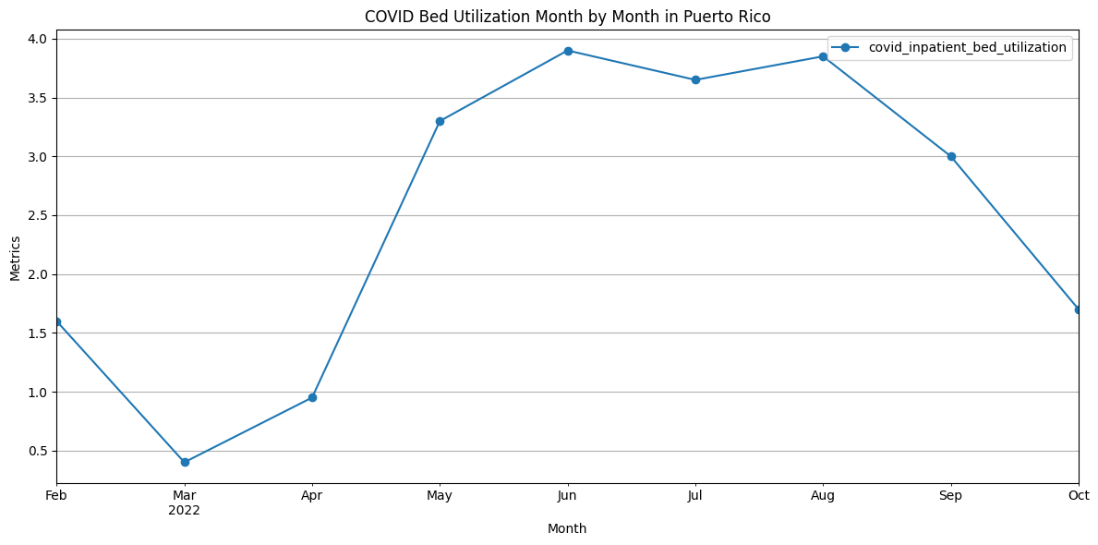
Median Bed Utilization month by month in P.R.

Slide 11
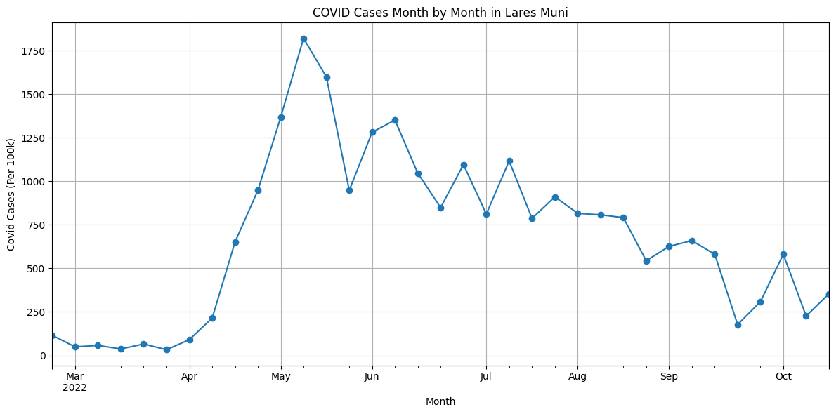
Month by month cases in Lares Muni

Slide 12
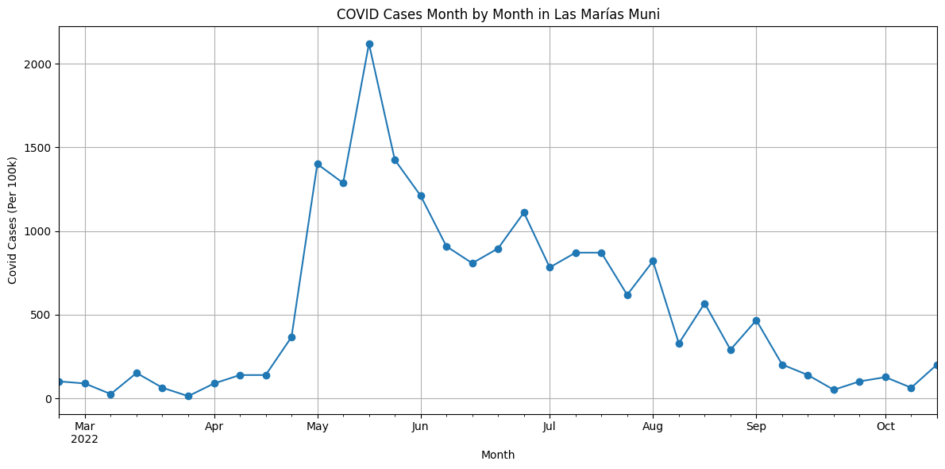
Cases month by month in Las Marías Muni

Slide 13
Analysis of the data for Puerto Rico
Based on the data, we can conclude that as the hospital admissions increased, the inpatient bed utilization increased linearly, indicating that there were more serious infections requiring bed rest when COVID was at its most severe in Puerto Rico.
The median cases and median
hospital admissions month by month
show that Puerto Rico’s hospital
admission rate was incredibly low as
compared to the number of cases in
2022.
We can see that May had the highest
median cases in Puerto Rico.

Slide 14
Analysis of bed utilization in Puerto Rico
The graph shows an increase in bed utilization between April and May, which corresponds to the uptick in confirmed COVID-19 cases in Puerto Rico.
The percentage remained near its peak for several months, following trends across the counties.

Slide 15
Analysis of the data for Lares Muni and Las Marías Muni
Both municipalities saw the highest increase in cases in May, but Las Marías overall had the lowest amount of cases out of all counties.
Despite this, Las Marías saw a higher peak than Lares in mid-May.
Lares Muni had a recorded population of 24,276 in the study.
Las Marías had a recorded population of 7,927 in the study.
Given that the cases_per_100k is adjusted to be ‘per capita’, the data is not necessarily susceptible to small populations but we may consider going by case percentage in the future.

Slide 16
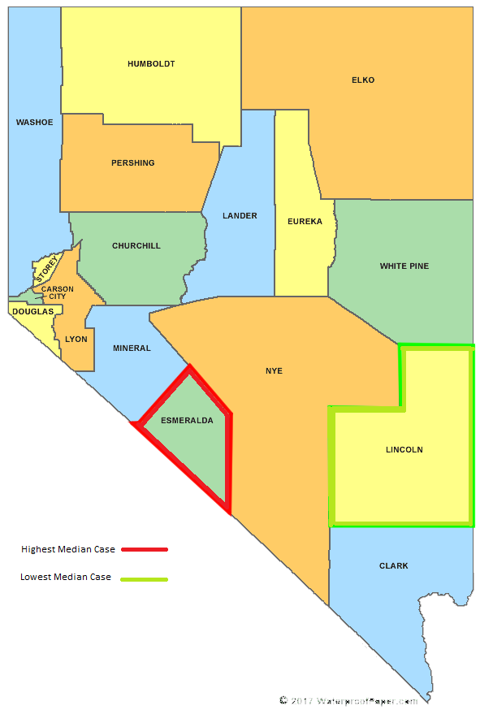
Results: Nevada
Lowest median COVID cases over 9 months: Nevada
Lowest median value: 38.42
County within Nevada with lowest median COVID cases over 9 months: Lincoln County
Lowest median value: 0
County within Nevada with highest median COVID cases over 9 months: Esmeralda County
Highest median value: 105.83

Slide 17
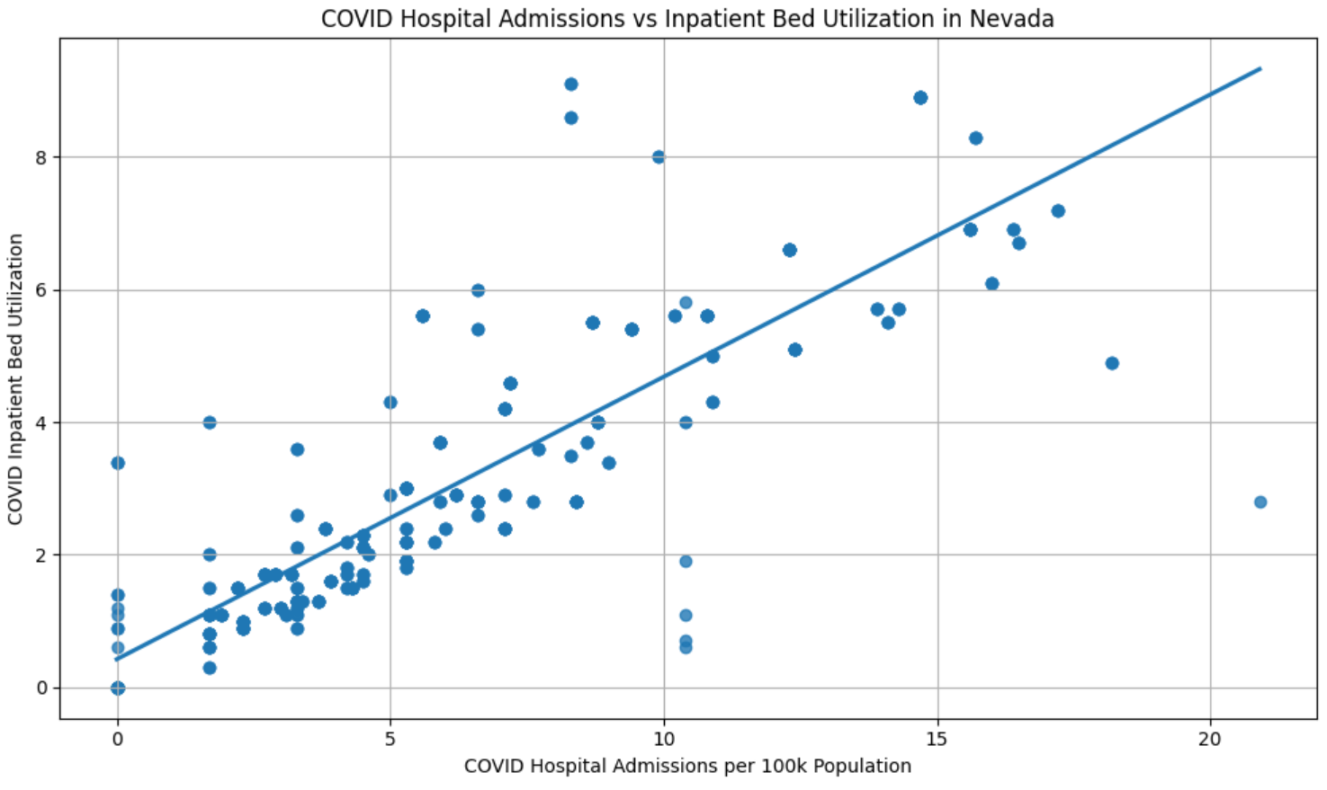
Results and Analysis: Nevada
Analysis:
Linear trend
With increasing hospital admissions, bed utilization rate increased.

Slide 18
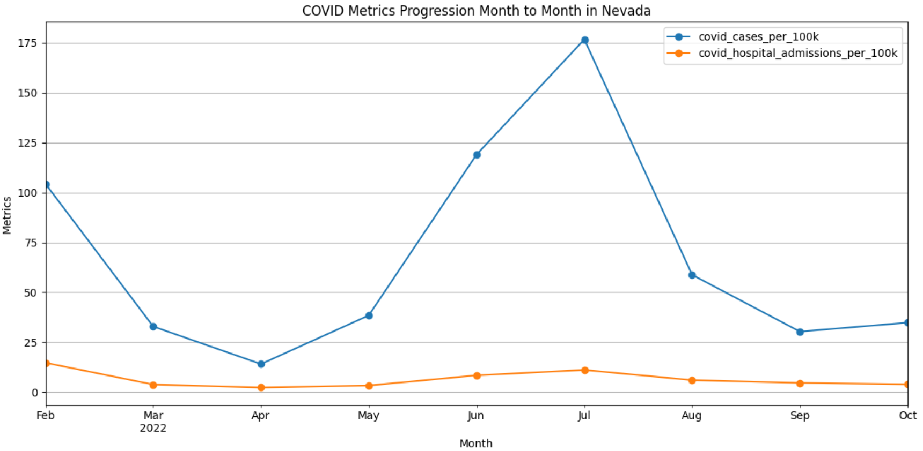
Results and Analysis: Nevada
Analysis:
Covid cases and hospital admissions follow a similar trend (in terms of shape)
July had the highest covid cases and hospital admissions (per 100K)
Covid hospital admissions very low compared to number of cases

Slide 19
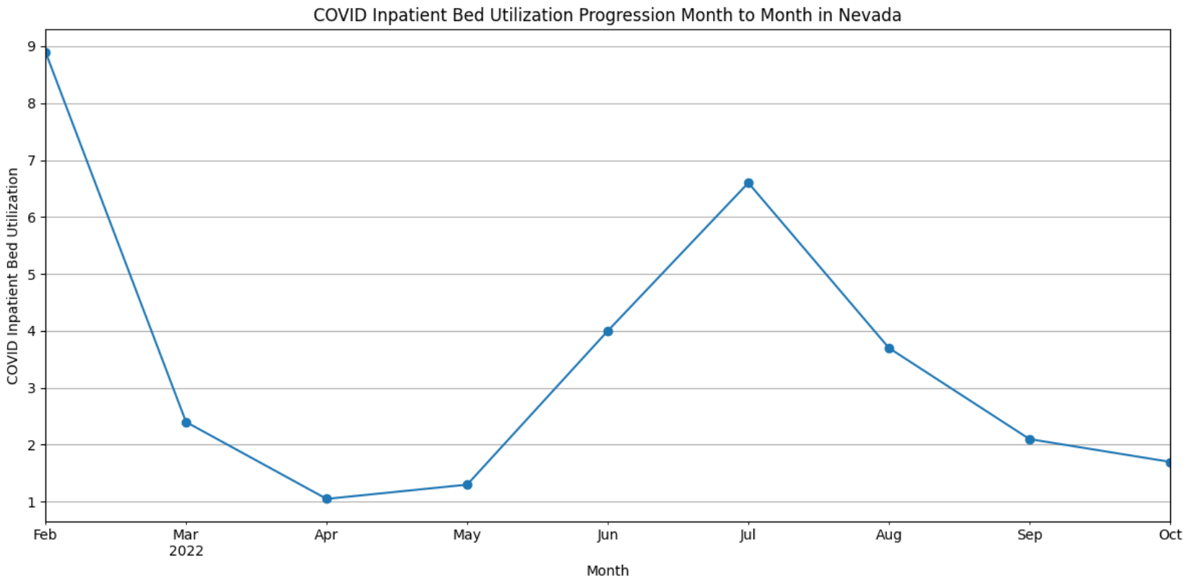
Results and Analysis: Nevada
Analysis:
Follows a similar trend to COVID cases and hospital admissions
Inpatient bed utilization peaked in February and July.
Inpatient bed utilization rate higher in February than July (when COVID cases was highest)

Slide 20
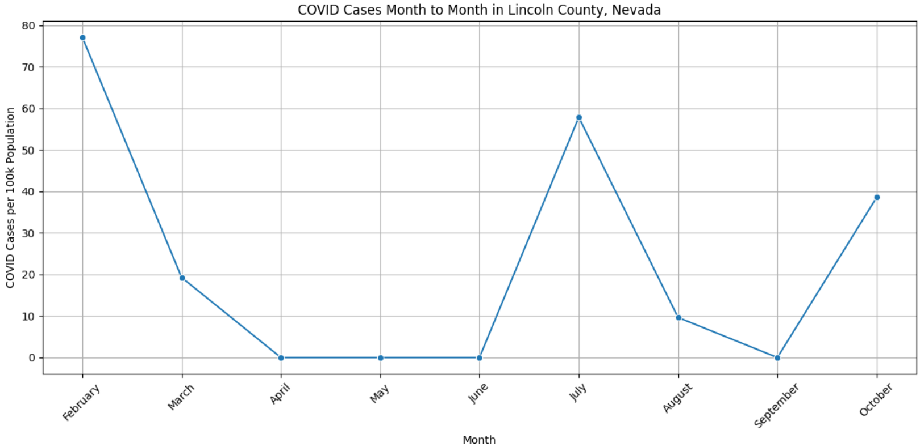
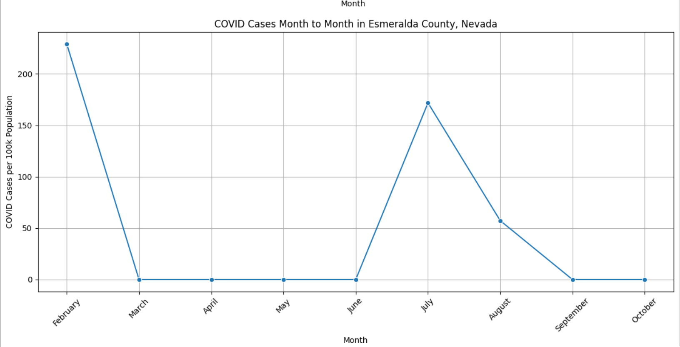
Results: Lincoln County (Lowest median) and Esmeralda County (Highest median)
Results:
Median population of Lincoln County: 5183
Median population of Esmeralda County: 873
Analysis:
The two counties follow a similar pattern to Nevada and each other.
Although, while COVID cases increased after September in Lincoln county, it remained at 0 for Esmeralda county
Esmeralda (highest median), had 0 COVID cases for 5 out of the 9 months
Esmeralda had very high peak in february (over 200) compared to the highest peak of Lincoln (around 78)

Slide 21
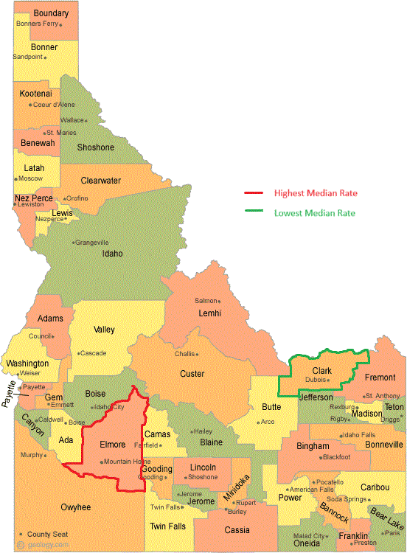
Highest and Lowest
Median Cases in Idaho
Elmore county, at 198.1 cases per 100k people (9.2 people per square mile, vs Ada County’s 470 people per square mile)
Clark County at a tie with Lemhi County at 0.0 cases per 100k people. It’s the least densely populated county in Idaho.
Notes:
The map shows the highest and lowest rates for the counties in ID outlined in red and green, respectively. Not surprisingly Clark County had the lowest rate. It is the least densely populated county in ID with 0.5 people per square mile.

Slide 22
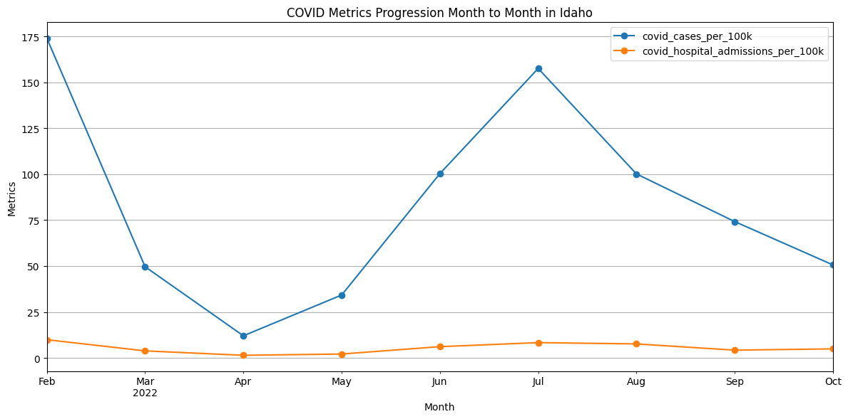
Idaho COVID rates over time
Notes:
Hospital admissions in Idaho were surprisingly low throughout, though they spiked a little when cases were at their peaks in February and July.

Slide 23
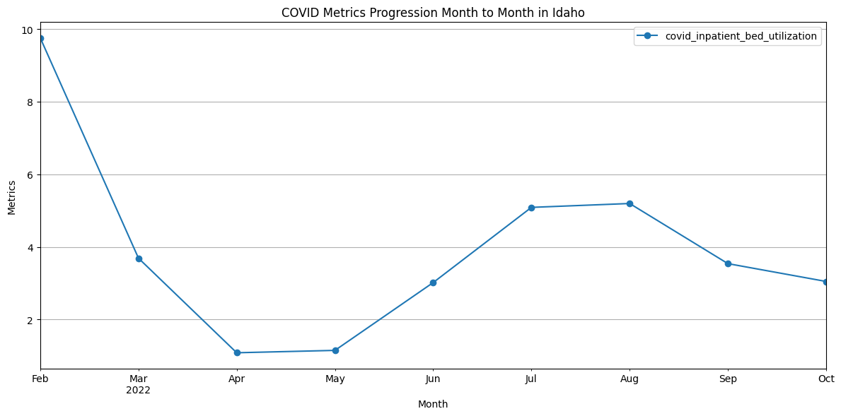
Overall Inpatient Bed Utilization for Idaho

Slide 24
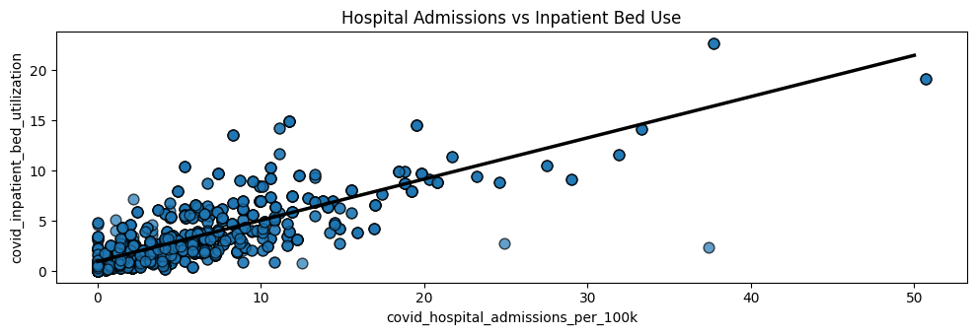
Notes:
As expected, there is a positive linear relationship between hospital admissions and bed use.

Slide 25
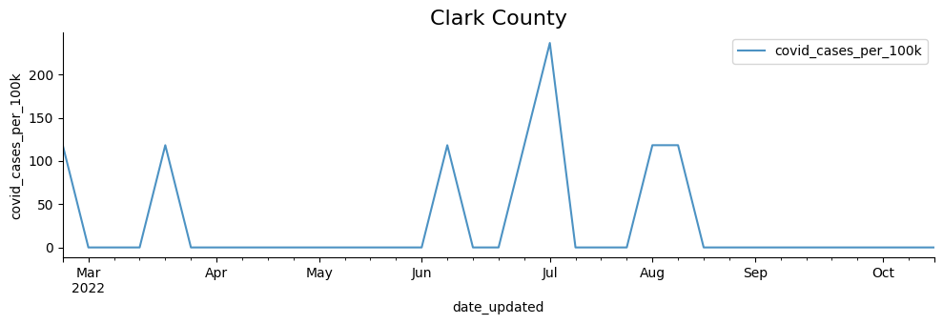
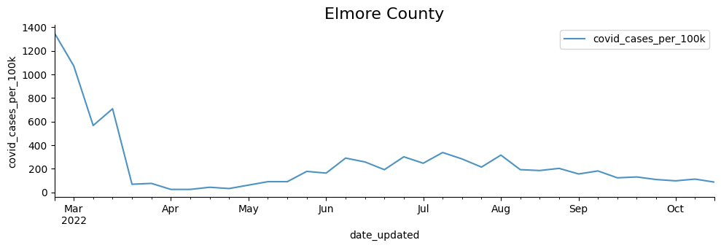
Counties with the Highest and Lowest Rates in Idaho

Slide 26
Similarities/Differences between all 3 states
Similarities
Both Idaho and Nevada’s median cases peaked in July (150-175 cases)
Low median hospital admissions vs. cases over time for all 3 states
Similar graphs of inpatient bed utilization
Nevada’s highest/lowest counties had similar shapes for the graph of COVID cases (different scales), similarly to Puerto Rico
All graphs of hospitalization vs. inpatient bed use show linear trend
Differences
Puerto Rico’s peak: 875 median cases. in mid-May
Idaho and Nevada peak: around 175 cases in July
Puerto Rico’s median lowest county had a higher peak than its median highest county, unlike the other states
Idaho’s highest/lowest median counties had very different graph shapes

Slide 27
Conclusion/Reflections
Puerto Rico was impacted the most by COVID-19 in 2022, with a very high peak cases per 100k in all counties.
All states had low hospitalization rates compared to their cases, indicating that less people were seeking hospital treatment for COVID-19 in 2022.
A limitation of our methods is that using median data may have impacted our results in a way that percentage-based data or mean-based data would not have.
Notes:
High rate in puerto rico was interesting because the Puerto Rican government took dramatic steps to control the sts of the virus, such as imposing a curfew and shutting down businesses. This high rate did not mean increased hospitalizations.
Perhaps hospitalizations were low in 2022 because it had less severe symptoms on average compared to previous years.

Slide 28
Works Cited
Centers for Disease Control and Prevention. (n.d.). Covid-19 by County. Centers for Disease Control and Prevention. https://www.cdc.gov/coronavirus/2019-ncov/your-health/covid-by-county.html
U.S. Census Bureau. (July, 1st, 2022). U.S. Census Bureau QuickFacts: Elmore County, Idaho. https://www.census.gov/quickfacts/fact/table/elmorecountyidaho/PST045222#PST045222.
U.S. Census Bureau. (July, 1st, 2022). U.S. Census Bureau QuickFacts: Custer County, Idaho. https://www.census.gov/quickfacts/fact/table/clarkcountyidaho/PST045222

